Slide 1
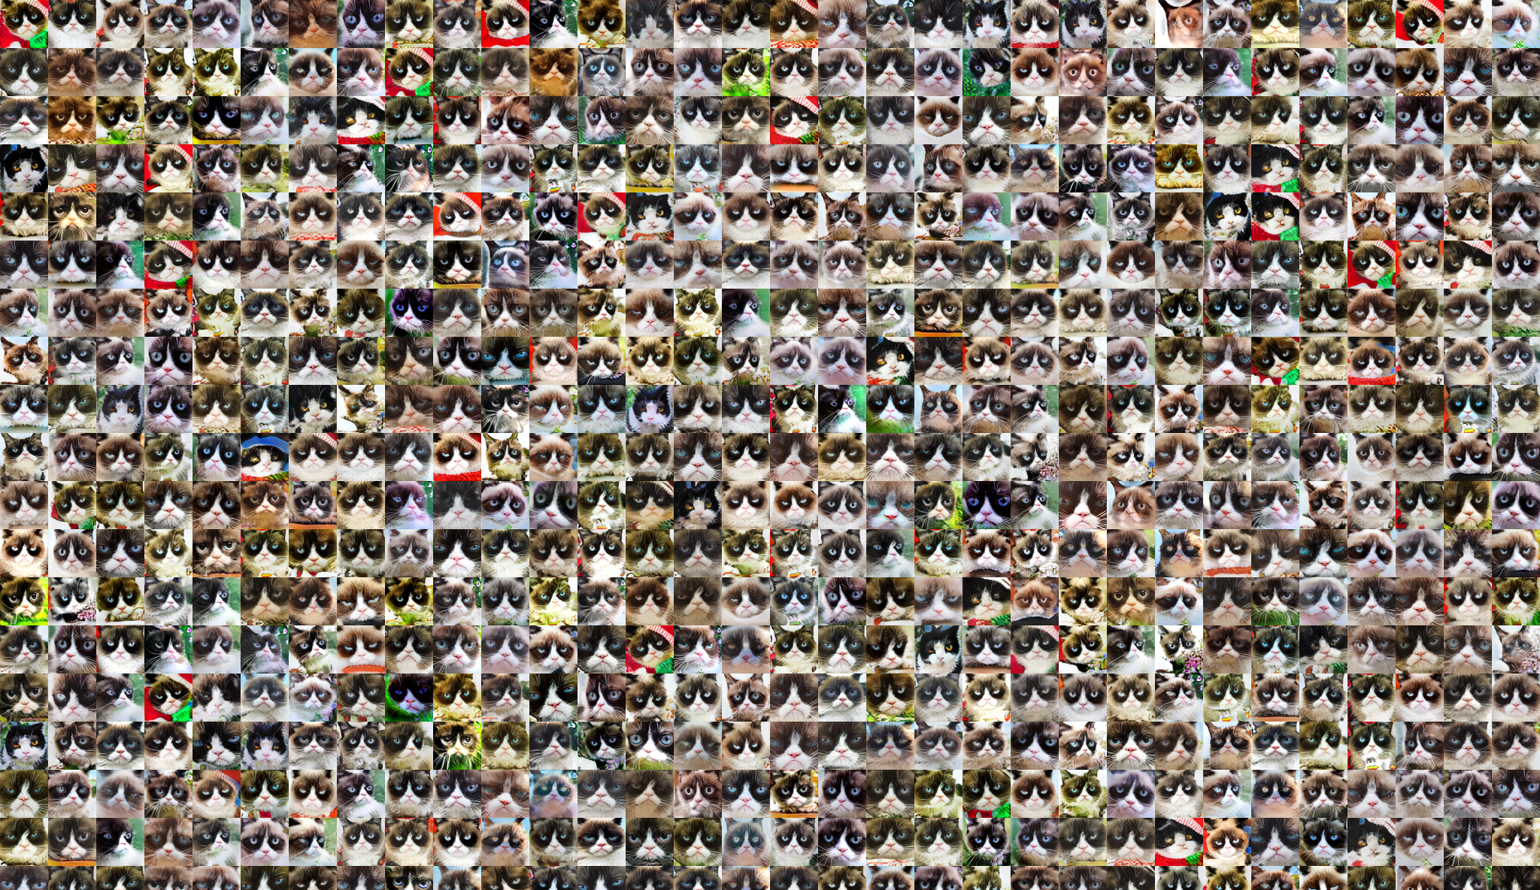
Assignment 3: CatsGAN
Due: 03/24/2021 Wed

Slide 2


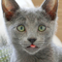
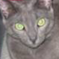




Dataset
Grumpy cats(204)
Russian blue(75)
Dataset used in Contrastive Unpaired Translation (CUT), Park et al, 2020

Slide 3
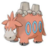


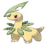


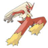
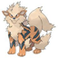




Bonus dataset (for B&W)
Fire
Grass
Water
and many other types….

Slide 4
What we will implement
Model architectures:
Discriminator
Generator
CycleGAN generator
Some training procedure
Logger
Forward backward pass
Other tricks to make GAN work
DCGAN
CycleGAN

Slide 5
Generator
z:100x1x1
256x4x4
128x8x8
64x16x16
32x32x32
3x64x64
deconv1
InstanceNorm ReLU
deconv2
InstanceNorm ReLU
deconv3
InstanceNorm ReLU
deconv4
InstanceNorm ReLU
deconv5 tanh

Slide 6
Discriminator
3x64x64
32x32x32
64x16x16
128x8x8
256x4x4
1x1x1
conv1
InstanceNorm ReLU
conv2
InstanceNorm ReLU
conv3
InstanceNorm ReLU
conv4
InstanceNorm ReLU
conv5

Slide 7
CycleGAN Generator
3x64x64
32x32x32
64x16x16
64x16x16
32x32x32
3x64x64
conv1
InstanceNorm ReLU
conv2
InstanceNorm ReLU
Residual block x 3 InstanceNorm ReLU
deconv1
InstanceNorm ReLU
deconv2 tanh

